Slide 1
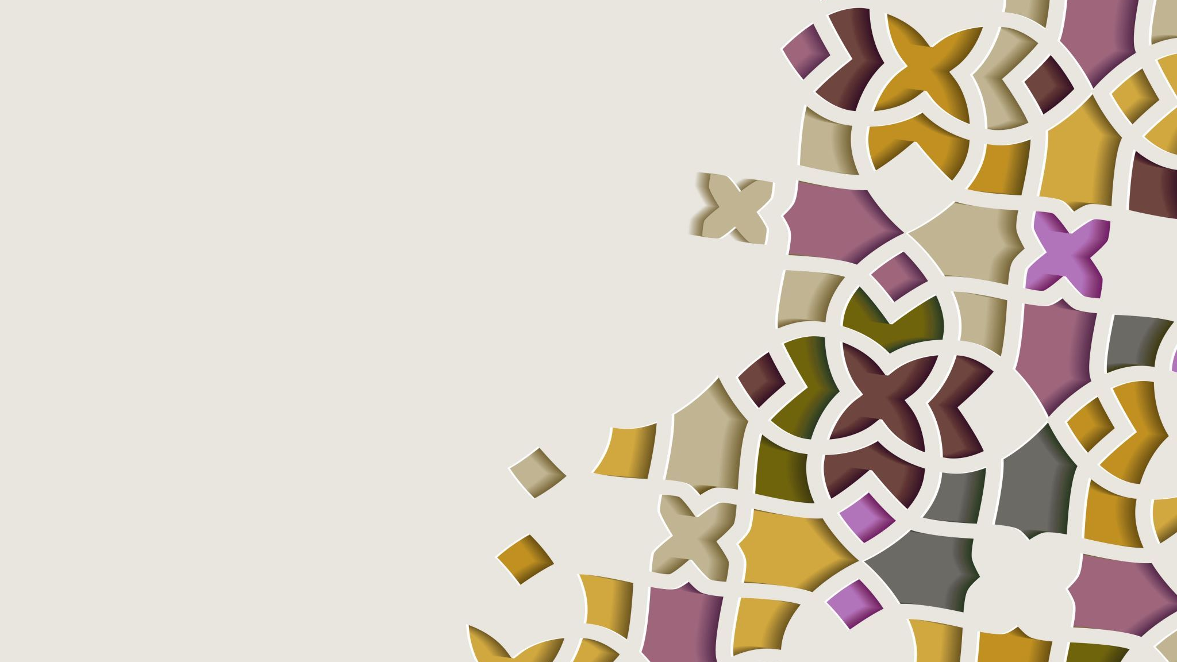
Forestview Technologies Project 2: Monthly Finance Tracker
Talha Ali, Mohammad Hoque, Soham Bhavsar, Maher Harkati, Amran Rahim

Slide 2
Introduction
The goal of this project was to give end users the ability track their finances on a month basis
Clients should have ease of access for all these operations and not worry about the behind the scenes.
This project allows users to add finances to the user interface and get a chart back showing the trend in their spending

Slide 3
Project Overview
Front End:
Website: Users are introduced to the Forestview team and the company's purpose. The projects tab showcases current and future projects, with downloads prompting users to accept terms & conditions, and technical compliance.
Back End:
The GUI does two things: - Accepts and stores input data - Displays input data in helpful graphs and charts

Slide 4
Tech Stack
Version Control & Collaboration:
GitHub Desktop was the main source of collaboration as different forks were created for the different tasks divided amongst team members. Visual Studio Code was the IDE used by the team for consistency and ease of use.
Front End:
HTML, CSS, and JavaScript
Back End:
Python – Tkinter & Turtle; In this application we made a couple of adjustments to the turtle in order for our new program to work correctly.

Slide 5
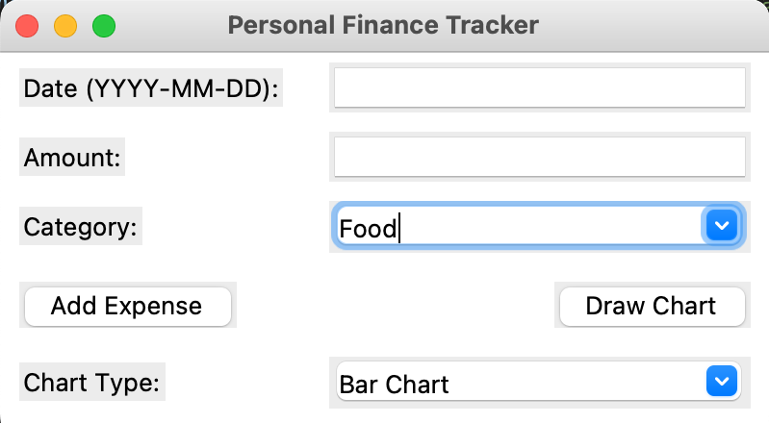
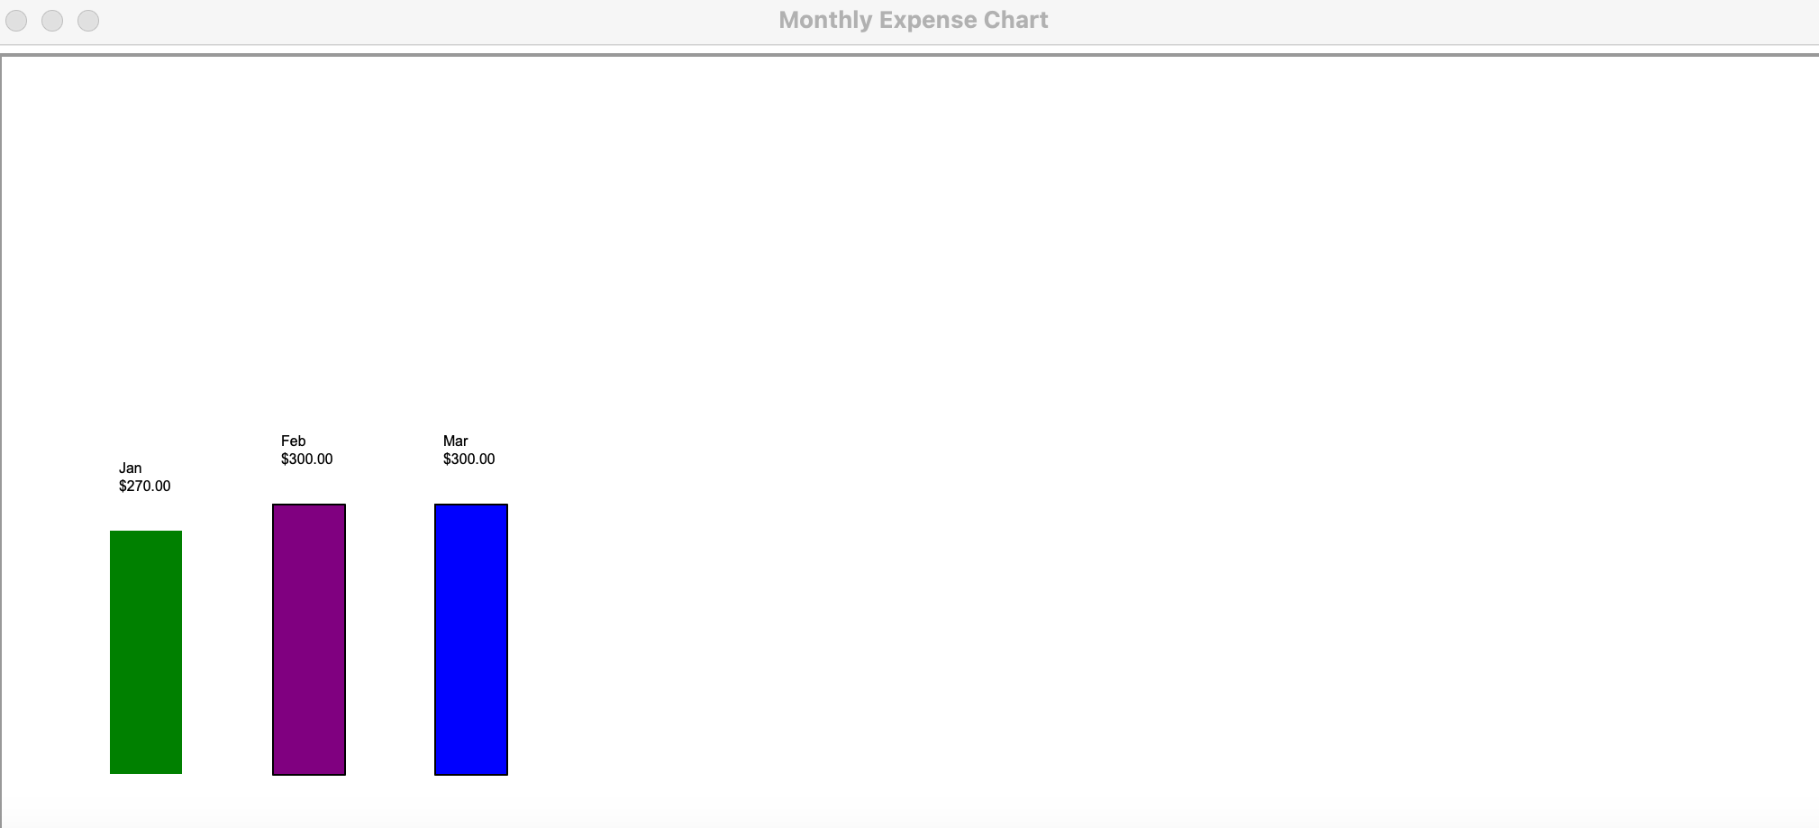
Project Demo

Slide 6
Challenges Along The Way
Front End: Frequent resizing and layout changes, coupled with a challenging syntax learning curve.
Back End: The places where we had problems were trying to get turtle to display the months the expenses happened.

Slide 7

Conclusion
Achieving our project goal, we've empowered end users with seamless finance tracking on a monthly basis. Through a user-friendly interface, clients effortlessly input and visualize their spending trends. The synergy within our team, coupled with well-defined roles, paved a smooth journey to success.

